Slide 1
JAC444 - Lecture 4
Segment 2 - clone Method

Slide 2
clone() Method
In this lesson you will be learning about:
Object method - clone
Cloneable Interface
How to override the clone method
Shallow versus deep cloning
Copy constructor versus clone

Slide 3
What is clone()?
•
D efinition: clone() is a method in the Java programming language for object duplication
E xamples: the assignment operator duplicates the reference, not the object
Student s1 = new Student(“John”, 3.5f); Student s2 = s1;
s1 and s2 are two references to the same object
Java Solution: The Object clone() method creates a copy of an object.
java.lang.Cloneable interface must be implemented by the class whose object clone we want to create.

Slide 4
Subtleties of clone() method
The header for clone():
protected native Object clone() throws CloneNotSupportedException;
clone() method is protected in Object class
Each class that wants to use clone method must override it and upgrade its visibility to public.
The class must implement the Cloneable interface
The Cloneable interface is a marker interface (does not have any methods)
If your class does not implement the interface Cloneable, then a
CloneNotSupportedException is thrown

Slide 5
How to override clone() method
Implement the Cloneable interface
Override the clone method with public access privileges
Call super.clone()- as the first statement
Handle CloneNotSupportedException

Slide 6
Deep vs Shallow clone
The shallow clone of an object will have exact copy of all the fields of original object.
If there are references to other objects as fields, then only references of those objects are copied into clone object, copy of those objects are not created.
The deep copy will copy all fields, but if the field is a reference to an object, the clone method will be invoked on the internal objects.
If the object to be cloned has only primitive type fields or Immutable objects then there is no difference between shallow and deep copy in Java.

Slide 7
Copy Constructor vs Clone
Object.clone() is protected; you need to implement clone() with public access
All its superclasses of your class should define
clone() method in them or inherit it
Copy constructors are in general better than
clone()

Slide 8
public class House implements Cloneable, Comparable<House> {
private int id;
private double area;
private java.util.Date whenBuilt;
public House(int id, double area) {
this.id = id;
this.area = area;
whenBuilt = new java.util.Date();
}
public int getId() {
return id;
}
public double getArea() {
return area;
}
public java.util.Date getWhenBuilt() {
return whenBuilt;
}

Slide 9
@Override /** Override the protected clone method defined in
the Object class, and strengthen its accessibility */
public Object clone() throws CloneNotSupportedException {
return super.clone();
}
@Override // Implement the compareTo method defined in Comparable
public int compareTo(House o) {
if (area > o.area)
return 1;
else if (area < o.area)
return -1;
else
return 0;
}
}

Slide 10
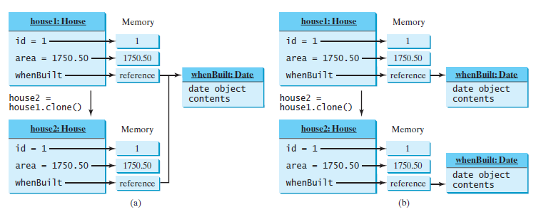
Shallow Copy
public class TestClone{
public static void main(String[] args){
House house1 = new House(1, 1750.50);
House house2 = (House) house1.clone();
}
}
Deep Copy
00

Slide 11
public Object clone() throws CloneNotSupportedException {
// Perform a shallow copy
House houseClone = (House)super.clone();
// Deep copy on whenBuilt
houseClone.whenBuilt = (java.util.Date)(whenBuilt.clone());
return houseClone;
}

